Slide 1
E - Commerce Purchase Data Analysis
M. Tech. – DSML → Team 7
Date: 24th Oct 2020
NPV – Project Presentation
PRAVEEN MANOHAR G
RAHUL A
RAJESH RAMACHANDER
RANJITH GNANA SUTHAKAR ALPHONSE RAJ

Slide 2
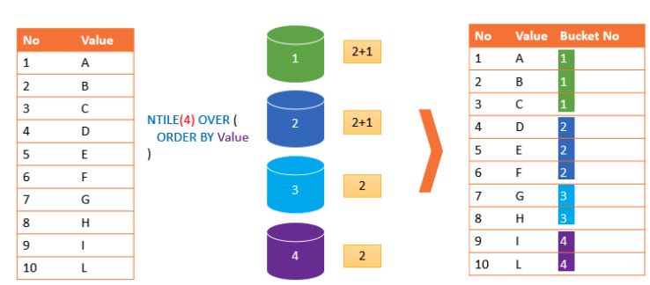
NTILE() – Overview and Logic
NTILE() function is used to divide data into Tiles(Groups) and returns the number of the tile to which the row belongs.
Part of the family ranking functions.
Format: NTILE(n) OVER (PARTITION BY <expression>[{,<expression>...}]
ORDER BY <expression> [ASC|DESC], [{,<expression>...}] )

Slide 3
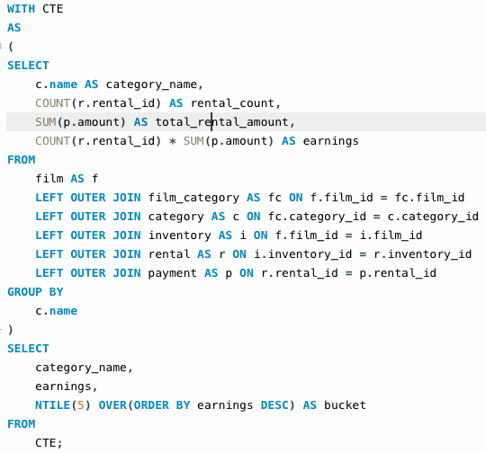
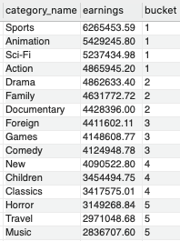
Classify the film genres into buckets of top earnings (rental count * rental rate)?

Slide 4
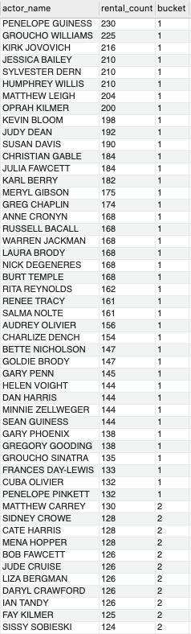
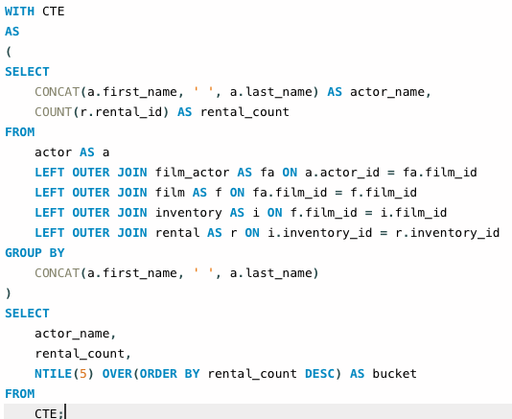
Classify actors into buckets of most rented (demand)?

Slide 5
Thank You!
Project Team
PRAVEEN MANOHAR G
RAHUL A
RAJESH RAMACHANDER
RANJITH GNANA SUTHAKAR ALPHONSE RAJ

